Slide 1
Hospital /homebound basics 2020 - 2021
Dr. Aronica Gloster, Coordinator – Health Services
Mrs. Wanda Hutcheson, Administrative Assistant
Richmond County School System
Notes:
Good morning and Welcome to the annual training for school hospital/homebound contacts and teachers on Hospital Homebound Basics.
I am Aronica Gloster, Coordinator for Health Services and I oversee the HHB program. Throughout the year, many of you will correspond with Mrs. Wanda Hutcheson, the administrative assistant who works diligently with me regarding HHB services.
Housekeeping:
Please mute your microphone
If you have questions, please use the chat feature and type it in

Slide 2
Topics covered
Overview
COVID-19 & HHB
Student Eligibility
Application Process
Attendance & Coding
Scheduling
Instructional Delivery
Instructional Materials
Termination of Services
Transition Back to School
Forms
Payroll
Notes:
Today, I want to touch on the topics as you see listed on this slide. I’ll provide a brief overview of the program, talk about COVID & HHB, student eligibility, the application process, attendance and coding, scheduling, instructional delivery and materials, termination of services, important forms, and payroll (how you get paid).

Slide 3
Notes:
This is a picture of the webpage where you can find information regarding HHB services. At the bottom of the page, the resources shown on the right can be accessed.

Slide 4
Hospital/homebound services Program informational booklet
Notes:
This is what the HHB services informational booklet looks like. It contains in detail the information discussed in this presentation.

Slide 5
2019 – 2020 HHB Stats
Total Number of Students Served = 149
Elementary = 27
Middle = 17
High = 98
Special Programs = 7
Full-Time = 101
Intermittent = 48

Slide 6
With covid-19, are we still providing HHb Services?
Students can still experience illnesses and injuries = absences
Encouraging students to utilize online platform
Each Homebound request will be reviewed on a case by case basis.
If approved, homebound instruction will be provided via phone and conference formats (Teams, Zoom,etc.).
At this time, no face-to-face HHB instruction will be provided
When circumstances change that allow for in-person HHB instruction, schools and families will be notified.
Students must meet eligibility criteria

Slide 7
What are hospital/homebound services?
GA State Board of Education Rule 160-4-2-.31
Hospital/Homebound (HHB) services are designed to provide continuity of educational services between the classroom and home or hospital for students in Georgia public schools whose medical needs, either physical or psychiatric, do not allow them to attend school for a limited period of time. HHB instruction may be used to supplement the classroom program for students with health impairments whose conditions may interfere with regular school attendance (e.g., students receiving dialysis or radiation/chemotherapy or students with other serious health conditions).
Notes:
GA State Board of Education Rule 160-4-2-.31 addresses HHB services
HHB services are designed to connect school and home to continue educational services for students who have physical and psychiatric conditions that don’t allow them attend school for a limited period of time. It can also be used to supplement instruction for students with health impairments that interfered with regular attendance -- ex. Dialysis or radiation/chemo, etc. Ideally, HHB services should promote transition back into traditional school setting.

Slide 8
What are hospital/homebound services?
Temporary in nature
Not intended to replace regular school services
Different from SPED homebased services and homeschool
Types of Hospital/Homebound Services:
Full Time
Intermittent
Long-Term
Notes:
The services are not designed to replace regular school services as students typically only receive a maximum of 3 hours per week, which is insufficient for mastery of all objectives. Should help facilitate transition back into traditional learning setting.
Different from SPED homebased services and homeschool
There are two basic types of HHB services:
Full-time -- for students who will be out 9 weeks or less, and a least a minimum of 10 days and cannot come to school at all – ex. student who might receive temporary services is one who breaks a limb and cannot bear weight, having to remain at home to prevent further injury
Intermittent – for students who will attend school, but may miss school periodically due to their condition. Example: A student has severe asthma that flares up periodically during the school year. The student will receive services after being absent 3 consecutive days due to a severe attack.
Some students will have long-term chronic conditions that require them to have regular treatment (dialysis, chemotherapy…) and would therefore qualify for long-term services. We do have some SPED students who are unable to attend school at all and qualify for full-time, long-term services; however, these students are few in number.

Slide 9
Student eligibility criteria
Eligible students must:
be enrolled in a Richmond County Public School;
have a medical and/or psychiatric condition that prevents school attendance documented by a licensed physician.
Only a psychiatrist can submit a medical request form for an emotional or psychiatric disorder.
The referring licensed physician and/or licensed psychiatrist must be the treating physician or psychiatrist for the medical and/or psychiatric condition for which the student is requesting HHB services.
Notes:
For a student to be eligible for HHB the child must be:
Enrolled in RCSS
Have a referral from physician or psychiatrist indicating that the student has a medical, emotional or psychiatric disorder. Please note that only psychiatrists can refer students with mental health conditions (anxiety, depression, etc.) not a pediatrician or even an licensed counselor or social worker. The referring doctor must also be currently treating the student. (ex. General pediatrician can’t refer for oncology/ cancer-related illness)

Slide 10
Student eligibility criteria, Con’t.
Eligible students must:
be anticipated to be absent a minimum of ten consecutive school days or;
for intermittent periods of time, anticipated to be absent to exceed ten school days during the school year.
If the school is on an approved block schedule, then the ten day minimum requirement is reduced to five consecutive or five intermittent days during the school year.
Notes:
3. Student must be anticipated to be absent a minimum of 10 consecutive days (full time services) or
Anticipated to be absent a total of 10 days or more during the school year for intermittent services.
If on the block schedule, the number of days threshold is reduced to 5.

Slide 11
Student eligibility criteria, Con’t.
Eligible students must:
Be free from influenza or other airborne contagious disease. A physician must certify that the student is not infectious.
Have the permission of a parent or guardian, unless he/she is an emancipated minor or student age 18 years or older.
Complete the HIPAA form relating to requested services
COVID-19 Update:
Asymptomatic students = not eligible for services; students should work using online modules with their regular teachers to complete work.
Symptomatic students = Students who receive positive test may be eligible to receive services after infectious period is over.
Notes:
Students must also be free from influenza or other airborne contagious disease. They can receive services after infection-risk is over.
Have the permission of a parent or guardian, unless 18 or older. Even if older than 18, we try to work with parents if they are living at home.
Complete the HIPAA form so that we can contact doctors if needed to clarify conditions.
COVID-19 Update:
Asymptomatic = not eligible for services; students should work using online modules with their regular teachers to complete work.
Symptomatic students = Students who receive positive test may be eligible to receive services after infectious period is over

Slide 12
TEACHER Qualifications
What are teacher requirements for HHB?
Employed by RCSS
Current GA Teaching Certificate
Preference is for teacher to be working at the same school in the grade level range of the student
SPED certification – required to work with SWD
Ability to adjust to a variety of home situations
Appreciation of cultural diversity
Ability to travel to and from or communicate with the student’s school of enrollment
Notes:
Next we’ll discuss teacher qualifications.
In order to serve as a HHB teacher there are requirements:
Employed by RCSS
Current GA Teaching Certificate
If student is out more than 20 days, best practice is to use a HQ teacher
Preference is for teacher to be working in the grade level range of the student
SPED certification – to work with SWD
Ability to adjust to a variety of home situations
Appreciation of cultural diversity
Ability to travel to and from or communicate with student’s school of enrollment

Slide 13
Application process
Parent contacts school
Each school has a designated HHB contact (administrator, counselor, social worker, nurse, etc.)
2. School provides parent with paperwork for parent and doctor
Letter explaining HHB services
HIPAA form
Medical form
The doctor returns the medical form to Student Services department for review by Coordinator. (Approval within 48 hours)
Within 5 days of receiving physician statement, the school must set a meeting to develop Educational Services Plan.
Can be face-to-face, verbal or email
ESP must be documented on a form. SST, 504 and IEP forms can be used
School needs to provide an HHB teacher
Services begin!
Notes:
Parents apply through the school HHB contact and complete the application. Forms no longer online for parents to access because they circumvent school.
If approval is granted, an Educational Services Plan meeting must be held. It can be face to face, verbal or by email. However, it should be documented. It explains the terms of the HHB services. SST, 504 and IEP forms can be updated to reflect the HHB services. HHB Teachers should be involved in the meeting to the extent possible. The meeting must be scheduled within 5 days of receiving the physican’s statement. We turn around paperwork and provide approval or disapproval within 48 business hours.
Until approved for services, the parent and school should collaborate to keep up with assignments.

Slide 14
When can services begin?
After completion of current application -- Applications have to be completed for each school year. Services do not automatically continue from year to year.
After approval is received from System Coordinator
Services can’t begin prior to the date of the doctor’s signature on the referral form.
Students approved for intermittent HHB services must be absent for three consecutive school days on each occurrence before HHB services will be provided.
Note: Chronic illnesses that require long term intermittent absences may require students missing many days, but possibly not three consecutive days. Systems are encouraged to use their discretion and evaluate these cases on an individual basis.
Students will be provided a maximum of three (3) hours of service per week
Notes:
When can services begin?
Applications have to be completed annually. Services don’t automatically continue from year to year.
Services cannot be granted to begin prior to the date of the doctor’s signature on the referral form.
It is important to know the type of services a child is receiving (full-time/intermittent). If a child is receiving intermittent services, the student must be absent for 3 consecutive days before services should be rendered. Therefore, it is important to maintain contact with the school or parent regarding weekly absences.
Note that students with chronic illnesses may not have to meet the three consecutive day threshold. We use a sliding scale for the students based on the number of absences for the week.
If absent 2 days = 1 hr
3 days = 1.5 hrs.
4 days = 2 hrs.
5 days = 3 hrs.
However, this schedule should be used only for those students who have situations like chemotherapy treatments, dialysis treatments, etc. Generally, students must be absent 3 consecutive days.

Slide 15
Sliding scale of services for students with chronic illness (dialysis, chemotherapy, etc.)
Days Absent | Hours of Service
2 | 1
3 | 1.5
4 | 2
5 | 3
Note: This scale is only to be used for students who have been diagnosed with a chronic illness warranting ongoing intermittent services (ex. dialysis, chemotherapy, etc.) All other students receiving intermittent services must be absent 3 consecutive days to receive services.
Notes:
This table shows how to provide services for students who are absent due to chronic illness.
1 day absent for each of these students is 36 minutes.

Slide 16
Delivery of Services
Where can services be provided?
Online
Student’s home
Health care facility
Library
Community Centers, Boys & Girls Club, etc.
Space should have
table or desk
well ventilated,
smoke-free,
Clean
Quiet
ESP should include location of services
*A PARENT, GUARDIAN OR OTHER DESIGNATED ADULT OVER THE AGE OF 21 MUST BE PRESENT FOR THE ENTIRETY OF SESSIONS.
Notes:
Next, let’s talk about the delivery of services – Where can they be provided?
The can be online – using Teams, Zoom, or other conferencing platforms.
They can be at the child’s home or another public venue
Should have table or desk, be well ventilated, be smoke-free, clean and quiet
Note where services are held in the ESP
A parent, guardian or other designated adult (indicated in ESP) over 21 should be present during sessions.

Slide 17
Delivery of Services
How and when are services scheduled?
The ESP will include the beginning and ending dates of services.
The HHB teacher and parent must communicate to determine the dates and times of services.
HHB services must be provided outside of contract hours.
HHB services must be scheduled for weekdays
HHB services are not provided during the Summer or holidays.
HHB Teachers must maintain contact with the student’s teacher(s) of record, HHB Contact and SDCS.
Notes:
This slide talks about scheduling services:
ESP must include beginning and ending dates
Teacher and parent communicate to determine the dates and times of services
The services must be provided outside of contract hours
The services are typically done on weekdays; Weekend services should be more rare, on a case-by-case basis with permission from District Coordinator
Generally services are not provided during the summer. We may be able to test a student, but otherwise services are not provided. The only other exception is for SPED students who receive extended year services. (We will look into summer services more)
In order to provide best services, HHB teachers must work in conjunction with the students’ scheduled teachers, HHB Contact . For SPEd students, this should include a thorough review of the IEP so that you are aware of goals. HHB teachers should not be independently assigning work; rather they are to help ensure school assignments are fulfilled.

Slide 18
delivery models and instructional delivery
What should happen during HHB session?
Direct Instruction
HHB teacher should provide student with assignments from school (if parent has not provided them)
HHB teacher provides instruction
HHB teacher leaves assignments for student to complete
HHB teacher returns to take assignments to students teacher of record
Tutoring/Remediation
Online Instruction – Canvas, Edgenuity, I-Ready, etc.
School must provide materials and books for students. It is the parent/guardian’s responsibility to pick up and sign-out books.
Ideally, HHB teacher should have Teacher’s Editions
Notes:
What should happen during HHB session?
Direct Instruction
HHB teacher should provide student with assignments from school (if parent has not provided them)
HHB teacher provides instruction
HHB teacher leaves assignments for student to complete
HHB teacher returns to take assignments to students teacher of record
Tutoring/Remediation
Online Instruction – Canvas, Edgenuity, I-Ready, etc.
School must provide materials and books for students. It is the parent/guardian’s responsibility to pick up and sign-out books.
Ideally, HHB teacher should have Teacher’s Editions

Slide 19
Instructional delivery
What subjects should be taught during sessions?
Emphasis should be put on core subjects (Math, English, Science, Social Studies)
The ESP team should explain specifics of instruction.
Students are still responsible for standardized testing (I-Ready, Benchmarks, GMAS)
Testing accommodations need to be considered, referenced in ESP and listed in 504 or IEP
Students are responsible for Career Development/ BRIDGE Bill requirements (coordinate with School Counselor)
Who grades assignments? The student’s teacher of record. It is not the HHB teacher’s responsibility to grade assignments.
Notes:
What subjects should be taught during sessions?
Emphasis should be put on core subjects (Math, English, Science, Social Studies)
The ESP team should explain specifics of instruction.
Students are still responsible for standardized testing (I-Ready, Benchmarks, GMAS)
Testing accommodations need to be considered, referenced in ESP and listed in 504 or IEP
Students are responsible for Career Development/ BRIDGE Bill requirements (coordinate with School Counselor)
Who grades assignments? The student’s teacher of record. It is not the HHB teacher’s responsibility to grade assignments.

Slide 20
Services for pregnant teens/parenting teens
Title IX prohibits sending students home simply because they are pregnant. Pregnant students can attend school unless their medical doctor determines they should be at home.
Pregnant students can receive Hospital/Homebound Services; however they must follow the referral procedures.
Post-Partum HHB services should be provided for six (6) weeks. A medical referral form must be completed.
For students who have complications during pregnancy, HHB referral procedures should be followed. Upon receipt and approval of a completed medical referral from a doctor, the student can receive HHB services prior to delivery.
Notes:
In past few years, procedures regarding pregnant students have changed.
Title IX prohibits sending students home simply because they are pregnant. Pregnant students can attend school unless their medical doctor determines they should be at home.
Pregnant students can receive Hospital/Homebound Services; however they must follow the referral procedures.
Post-Partum HHB services should be provided for six (6) weeks. A medical referral form must be completed.
For students who have complications during pregnancy, HHB referral procedures should be followed. Upon receipt and approval of a completed medical referral from a doctor, the student can receive HHB services prior to delivery.

Slide 21
ATTENDANCE
Attendance
Students should be marked absent (excused or illness if known) until services are provided.
For every 3 hours of service, a student can be marked present for the entire week
The code of “H” should be entered in Infinite Campus
The code is entered after the services have been rendered. Schools are not to assign students the code of “H” for the entire year.
If services are cancelled and not made up, the student is to be marked “absent.”
It is the responsibility of the HHB teacher to notify the school’s Homebound Contact and student’s homeroom teacher/teachers of HHB services rendered
If a session is cancelled due to absence of a parent/guardian, the session should not be rescheduled and the student will be counted absent.
Notes:
Will also work with SDCS with attendance.
1.. Regarding attendance – students should be marked absent until services are provided.
It is the HHB teachers’ responsibility to notify the homeroom teacher or HHB contact if services are rendered.
If the student receives 3 hours of service during the week, he/she may be counted present for the entire week.
Schools must not put in “H” code until validation of hours served is provided.
Sessions cancelled without valid reasons should not be rescheduled and the student will be counted absent.

Slide 22
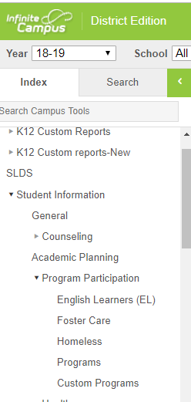
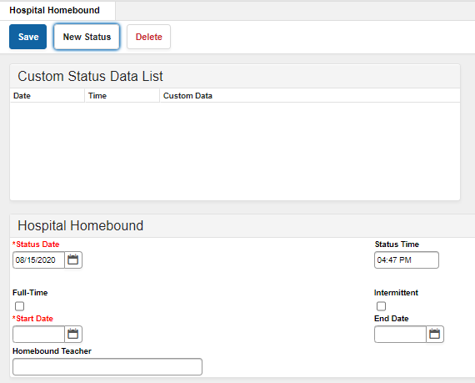
ATTENDANCE
Notes:
Last year, we began as one of our steps at the district office – entering information into IC so that schools can easily see if a student receives HHB services. It is not yet a flag, but has been requested. Schools will also be able to generate reports and we will too!
Ms. Hutcheson enters this information each time we approve a referral and receive the teacher’s name.
The information is entered under custom programs. The image on the right shows what the entry screen looks like.

Slide 23
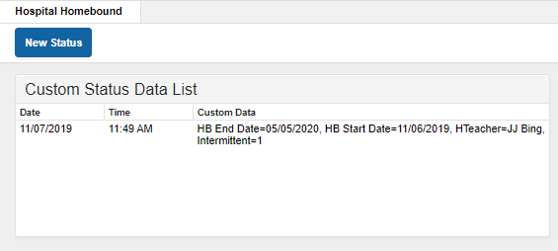
ATTENDANCE
Infinite Campus
Notes:
This slide shows a completed student entry.

Slide 24
ATTENDANCE
Student meets eligibility and is approved for HHB services.
Student misses school. The appropriate absence code is entered in Infinite Campus. (Ex. absence is marked "excused" or "illness" if the cause is known.)
HHB Teacher informs HHB School Contact and SDCS that services have been provided. (If a student is in a facility, verification of HHB instructional services provided will come from the facility.)
HHB Teacher is notified of student absences by teacher of record, HHB School Contact or parent.
HHB Teacher provides services to the student. The services are recorded on the payroll form. (Teacher provides 3 hours service = student can be counted present for the week.)
Approved beginning and ending dates for services are entered in Infinite Campus.
Student's attendance record is updated to show he/she received HHB services for the days absent. The code of "H" is entered for absences. If the student received 3 hours, the "H " code is used for the week.
Notes:
So here are the steps that should take place regarding attendance:

Slide 25
Termination of services
How are services terminated?
1. The licensed physician or psychiatrist recommends that the student return to school, as of the projected return date on the HHB Medical Form.
2. The licensed physician or licensed psychiatrist indicates that the medical condition has changed from what was defined in the ESP.
3. The student’s absence extends beyond the estimated length of service stated by the physician. (At this point, the parent will be required to obtain an updated form from the physician.)
4. The student graduates or the school year ends.
5. The student withdrew from the school system
Notes:
How are services ended? There are 10 circumstances:
The doctor’s projected date on the medical form indicates the services should end
The child’s condition changes – as documented by physician/psychiatrist
Student’s absence is longer than what is on the medical form – in which case updated info. Must be obtained
School year ends
Student withdraws from the system.

Slide 26
Termination of services
6. The student does not assume responsibility for the completion of assignments.
7. The student is employed in any capacity, goes on vacation, regularly participates in extracurricular activities or is no longer confined at home.
8. The parent cancels three sessions without 24-hours’ notice
9. The conditions of the location for HHB services are not conducive for instruction or threaten the health and welfare of the teacher.
10. The parent chooses to end the services
Notes:
The student isn’t doing the assigned work. (Contact School HHB coordinator in such a case. Don’t just stop going and not notify anyone.)
The student is working, on vacation, extracurricular activities or isn’t confined to the home
3 parent-cancelled absence without 24 hours’ notice
Conditions for HHB services aren’t conducive or threaten the welfare of the teacher
Parent ends services

Slide 27
Forms: Educational Services Plan (ESP)
Required by GADOE
A plan that delineates the HHB services to be provided to the student
Can utilize the IEP or 504 or form provided in manual
Agreed upon by parent/guardian, HHB contact and other designated school staff
Can be face-to-face, phone, or electronic
Must be scheduled within 5 days after receipt of the medical form
Upload into “Person Documents Tab” on IC (if not in 504 or IEP)

Slide 28
Educational Services Plan (ESP)
Notes:
This slide shows the ESP which includes general information including beginning and end dates of services, teacher info, medical considerations, other adults who may be present in the absence of the parent, courses and medical accommodations. There is also space provided for a re-entry plan and for signatures of all participants.

Slide 29
Forms & payroll
How will I be paid as a HHB teacher?
Rate of Pay: Teachers will be paid on a per hour rate of pay calculated by years of experience and certificate level. This is for no more than three (3) hours per week of instruction. The calculation for additional time allotted for planning/travel will be calculated by the Department of Student Services and added to your payroll
Payroll Forms
MUST BE SUBMITTED MONTHLY
Due by the cut-off date in Student Services – forms not received by the date indicated will be included on the next payroll.
Only originals will be accepted (Due to COVID-19, emails and electronic submissions will be accepted)
Must be signed by the principal of the school that the student attends
Each session must be listed individually,
Each session must be listed with date, beginning and ending times, and description of activities.
Must have a parent/guardian signature for each individual session
Teacher signature is required
All areas of the payroll form must be completed
Notes:
How will I be paid as a HHB teacher? No one wants to work and not receive fair compensation; however there are a few things that can cause problems.
Rate of Pay: Teachers will be paid on a per hour rate of pay calculated by years of experience and certificate level. This is for no more than three (3) hours per week of instruction. The calculation for additional time allotted for planning/travel will be determined by the Department of Student Services and added to your payroll
Payroll Forms
Turn in forms on time -- Due by the cut-off date in Student Services – forms not received by the date indicated will be included on the next payroll.
Originals are required -- Only originals will be accepted*
Must be signed by the principal of the school that the student attends – they must be accounted for by the school. This is a good time to provide a copy to the HHB contact to ensure attendance is corrected.
Each session must be listed individually, complete with date and time
Must have a parent/guardian signature for each individual session
Teacher signature is required
All areas of the payroll form must be completed.
Any areas missing will delay processing.

Slide 30
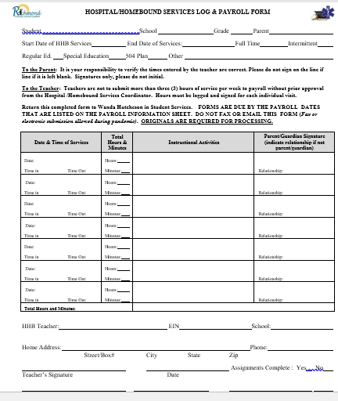
Services log/payroll form
Notes:
This slide shows the form and required areas to be completed

Slide 31
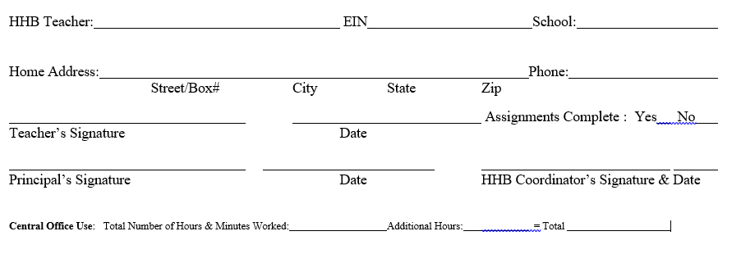
Sample time sheet

Slide 32
Submitting payroll during pandemic
Option 1: Live Signatures and Email/Fax
Take form to parent and principal for signatures.
Email completed form to Student Services (Ms. Hutcheson)
Option 2: Email Verification from Parent and Principal
Send email to parent listing dates, times, instructional activities for each session. Ask the parent to verify that the information is accurate.
Forward the parent verification email, along with the dates, times and instructional activities for each session to your principal. Ask the principal to send an email back indicating approval.
Send to Ms. Hutcheson in one email the following:
HHB Payroll form with teacher signature and dates, times and instructional activities AND
Verification emails from (1) parent and (2) principal

Slide 33
Submitting payroll during pandemic
Option 3: PDF Signature
Send form to parent for signature via Adobe PDF. Ask parent to sign and return to teacher.
Teacher sends form complete with teacher and parent signatures to principal. Principal signs form
Principal can send back to teacher.
Teacher sends form with completed electronic signatures to Ms. Hutcheson.

Slide 34
Other Available forms and Documents
Physician Certification – Release to Return to School
Teacher Informational Letter
Homebound Teacher Information Form
Georgia State Board Rule Regarding HHB Instruction
Frequently Asked Questions
HHB Parent Survey – NEW!
Infinite Campus HHB Tab – 2019

Slide 35
Other Final reminders
Complete and return “Hospital/Homebound Training Verification Form”
HHB Services are not Homebased Services provided by SPED
Students must meet medical eligibility to receive hospital/homebound services
HHB Services are not the same as home schooling
Confidentiality is imperative!
Sharing student health information with those who do not have a legitimate educational need is a violation of FERPA
Sharing health information can also be a violation of HIPAA legal guidelines
Original payroll forms must be in Student Services by 5:00 PM on the date listed in the HHB manual.
Payroll forms must have description of services provided
Notes:
Sometimes there is confusion about homebased services provided for SWD who have behavioral issues preventing them from attending regular school day. The services described today apply only to students who meet medical eligibility.
HHB is not the same as home schooling.
Confidentiality regarding student’s conditions, academic performance must be maintained. This information should only be shared on a need-to-know bais.
Original payroll forms are due by 5:00 PM on the date listed in the manual – No Exceeptions.

Slide 36
Contact information
Aronica Gloster
Coordinator – Health Services/HHB
glostar@boe.Richmond.k12.ga.us
(706)826-1129 or ext. 5501
Wanda Hutcheson
Administrative Assistant – Student Services/HHB
hutchwa@boe.Richmond.k12.ga.us
(706)826-1000 x 5190

Slide 37
THANK YOU FOR HELPING RCSS STUDENTS TO SUCCEED!

